Slide 1

The Semantic Segmentation Problem
Course 3, Module 5, Lesson 1
Semantic segmentation is useful for a range of self-driving perception tasks such as identifying where the road boundaries are and tracking motion relative to lane markings.
⾃動運転以外：from tumor（腫瘍「しゅよう」） segmentation in CAT scans, to cavity（空洞「くうどう」） segmentation in tooth x-ray images.

Slide 2

Learning Objectives
• Learn the semantic segmentation task problem
formulation
• Learn to determine how well a semantic
segmentation model is performing with task relevant
performance measures
module 4の2D object detectionと同じように、先に問題記述や評価⽅法を説明する！

Slide 3
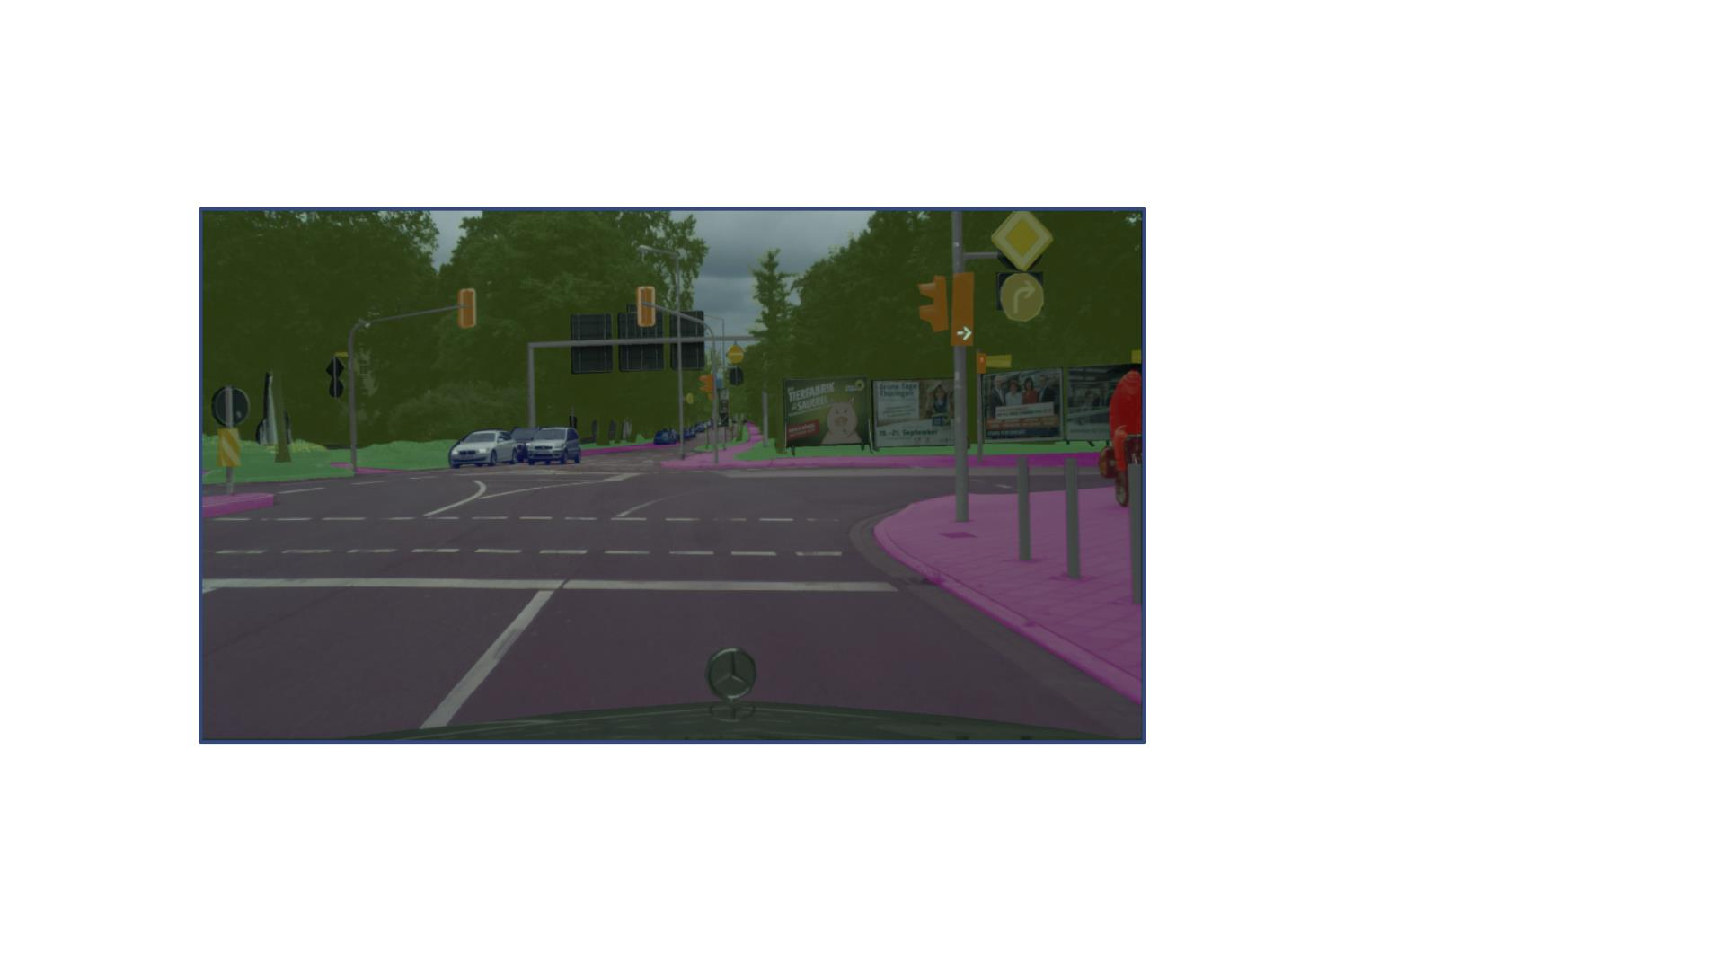
The Semantic Segmentation Problem
• Road
• Sidewalk
• Pole
• Traffic Light
• Traffic Signs
• Vegetation
• Terrain
• Sky
• Car
• Background
Given an input image, we want to classify each pixel into a set of preset categories.
Categories - static road elements: road, sidewalk, pole, traffic light, traffic sign.- dynamic obstacles: car, pedestrian, cyclist. - background class, vegetation(植生「しょくせい」), terrain（地形）, sky.

Slide 4
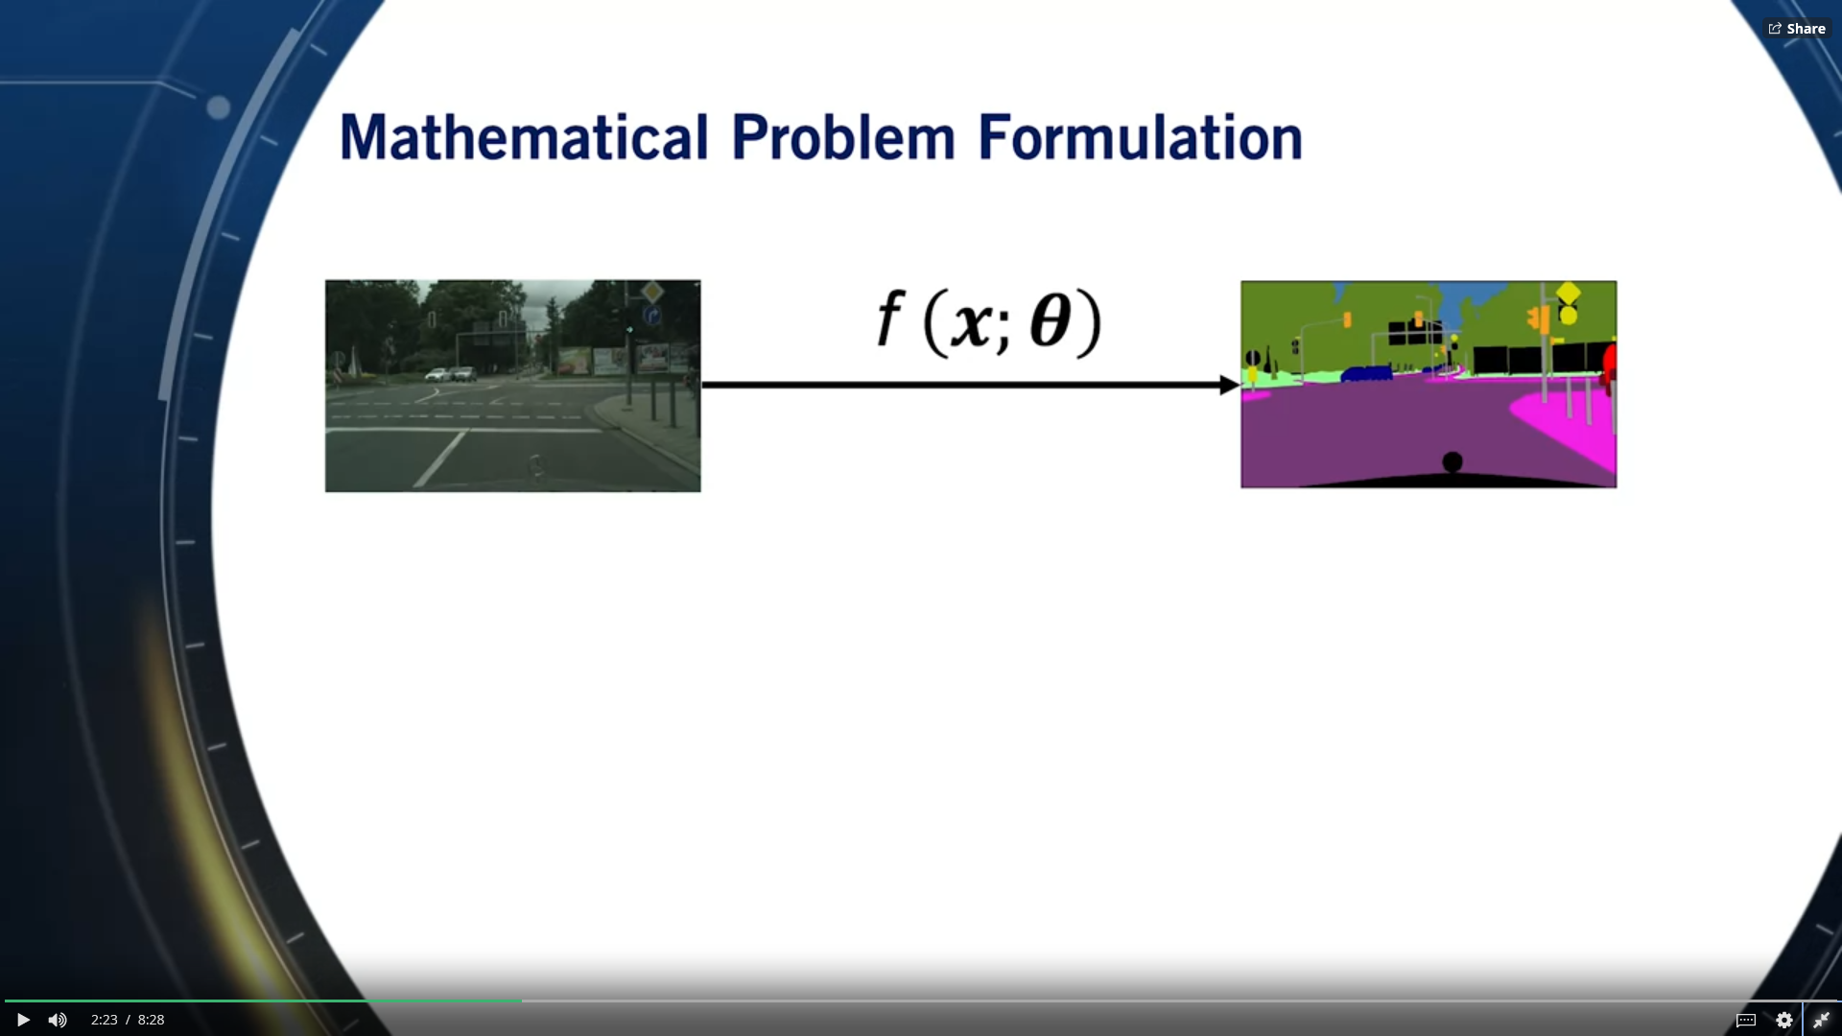

Slide 5
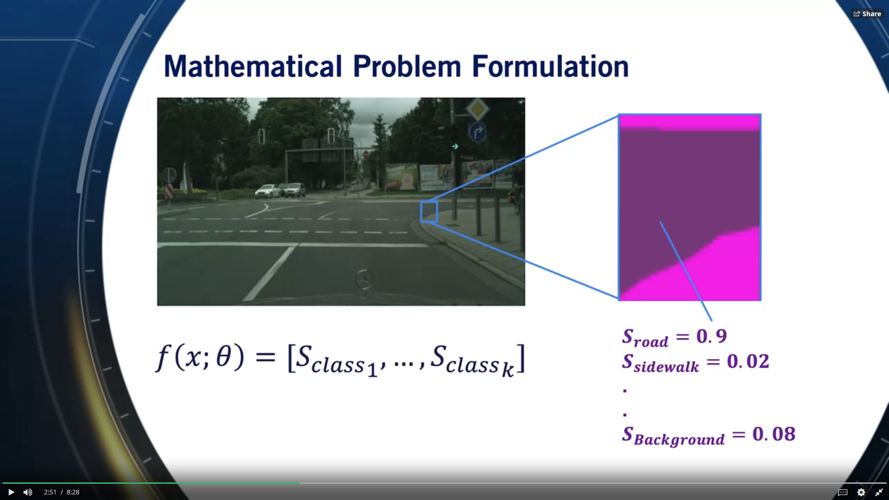
input: every pixel.

Slide 6
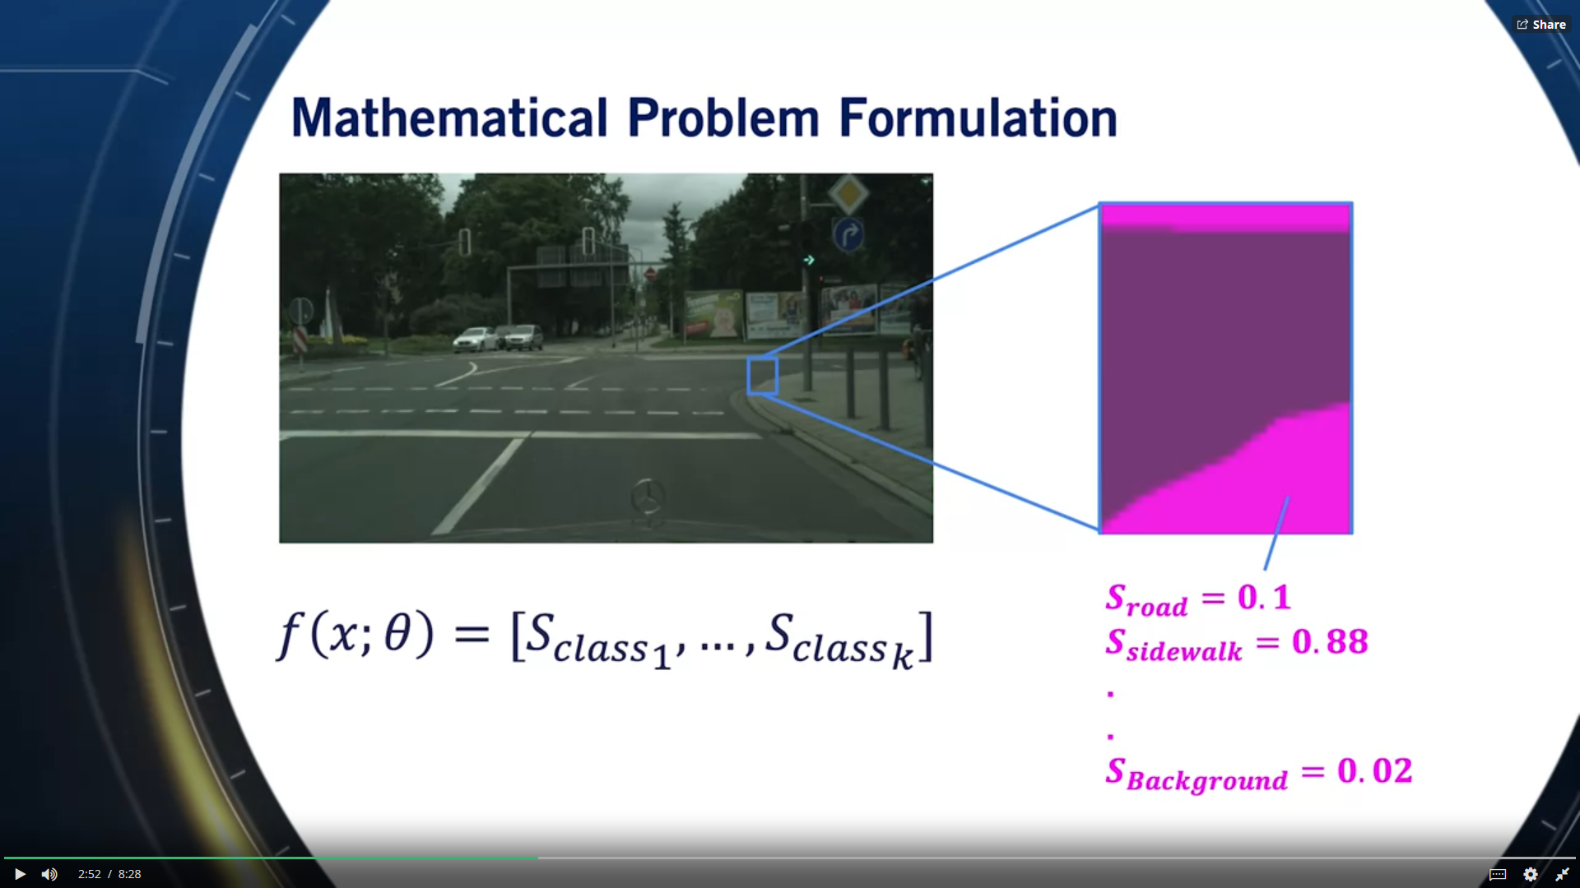

Slide 7
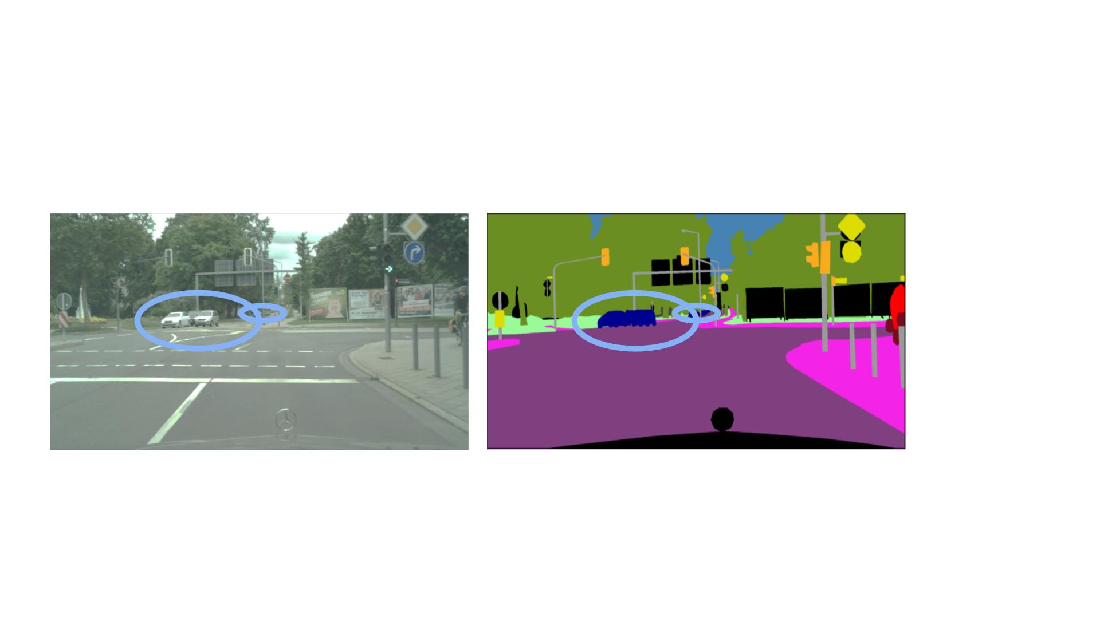
Semantic Segmentation is Not Trivial !
• Occlusion, truncation, scale, and illumination changes

Slide 8
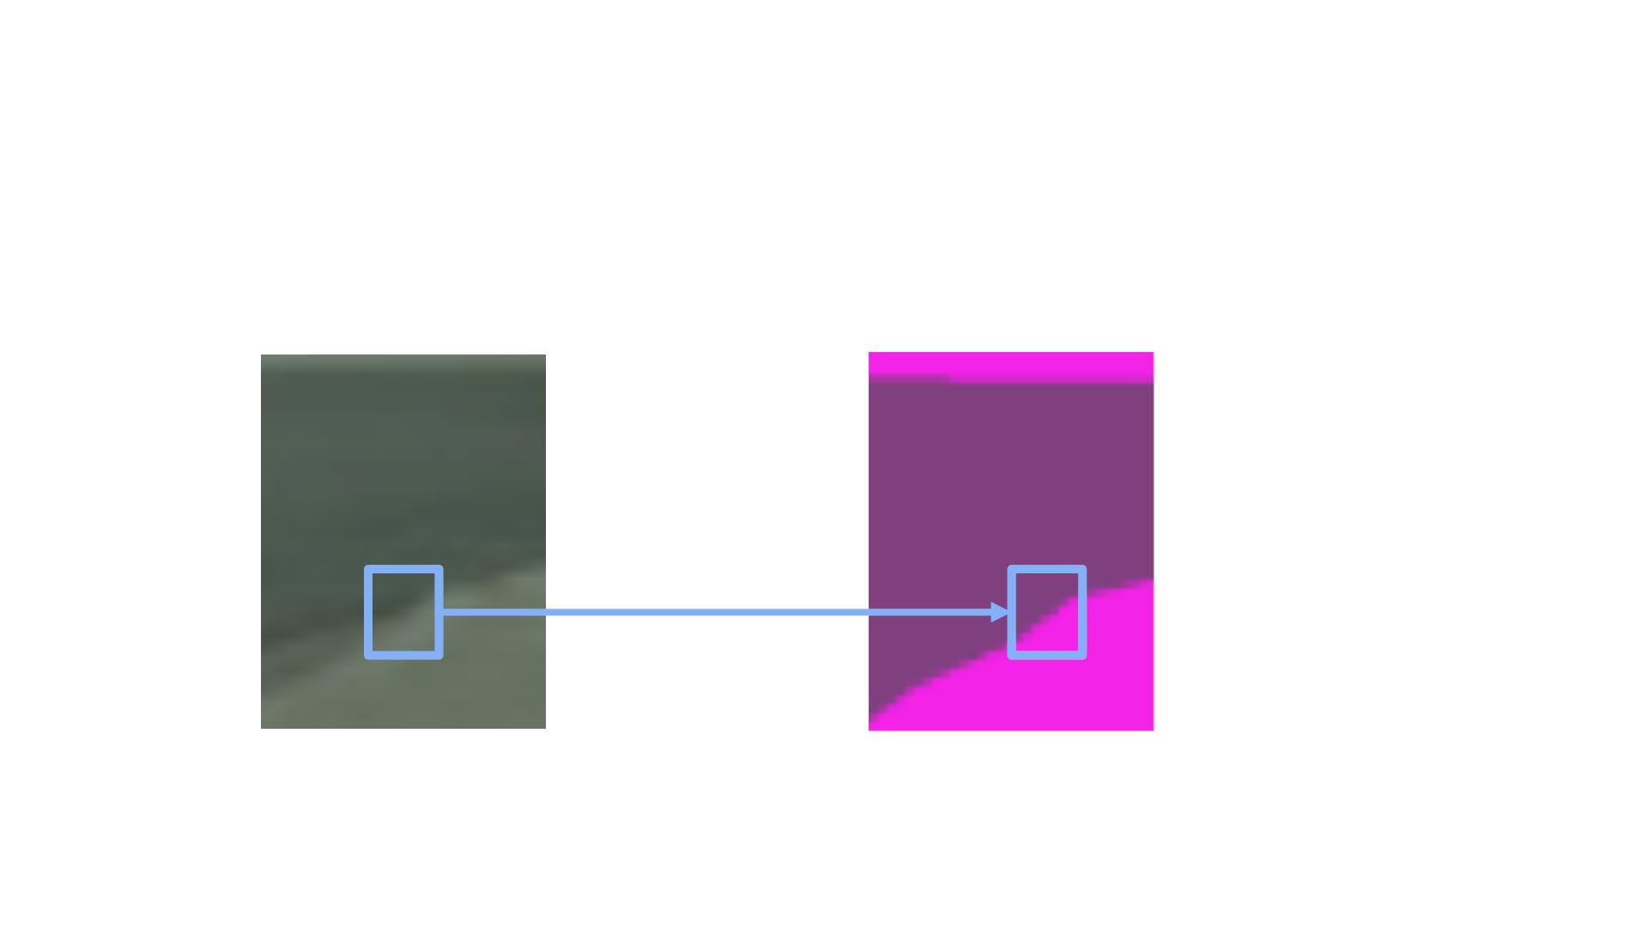
Semantic Segmentation is Not Trivial !
• Occlusion, truncation, scale, and illumination changes
• Smooth boundaries
an ambiguity of boundaries in image space.
thin objects, such as poles.
similar looking objects, such as a road and a sidewalk.
faraway objects.

Slide 9
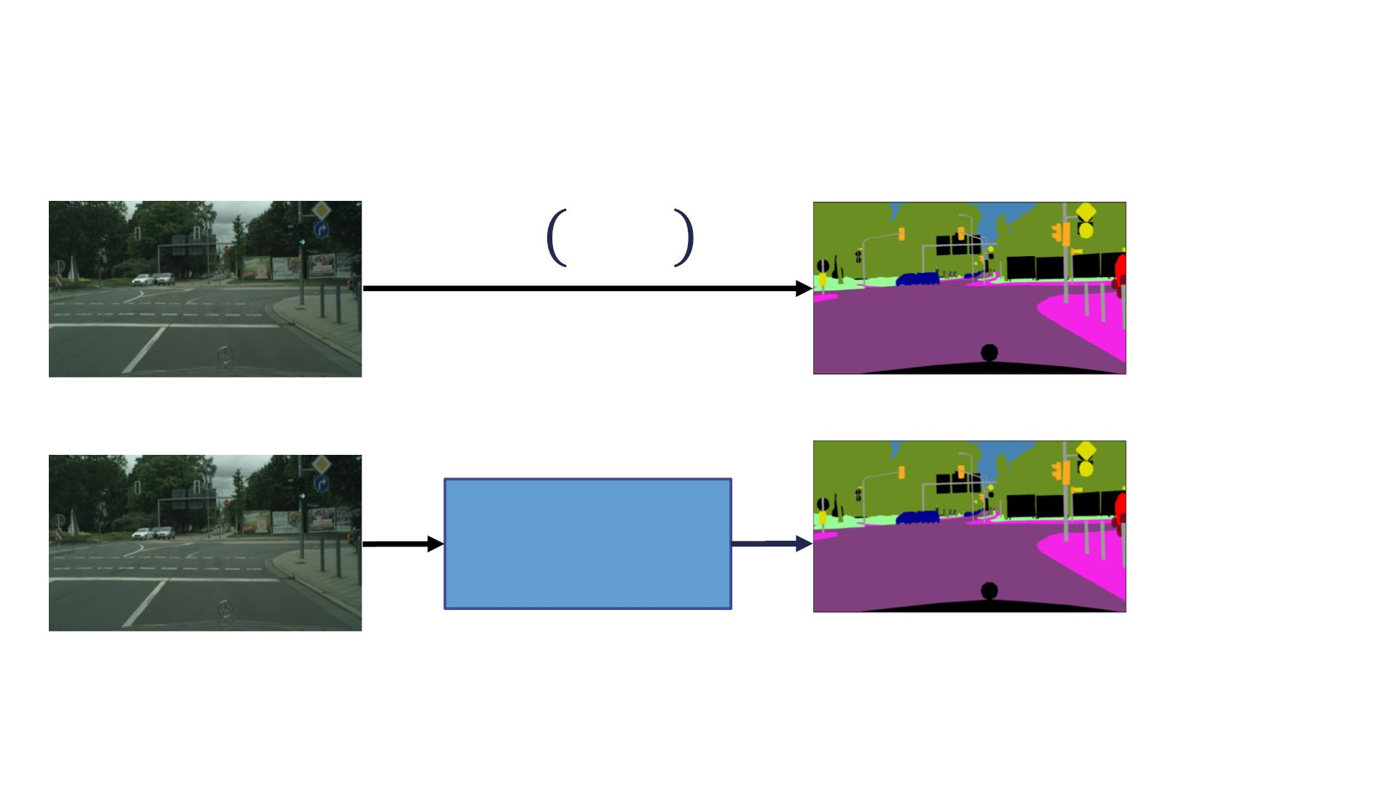
ConvNets For Semantic Segmentation
! "; $
ConvNet

Slide 10

Evaluation Metrics
• True Positive (TP): The number of correctly classified
pixels belonging to class X
• False Positive (FP): The number of pixels that do not
belong to class X in ground truth but are classified that
class by the algorithm
• False Negative (FN): The number of pixels that do belong
to class X in ground truth, but are not classified as that
class by the algorithm
%&
!"# =
!"#$$
%& + (& + ()
注意：Class毎に計算するんだ！

Slide 11
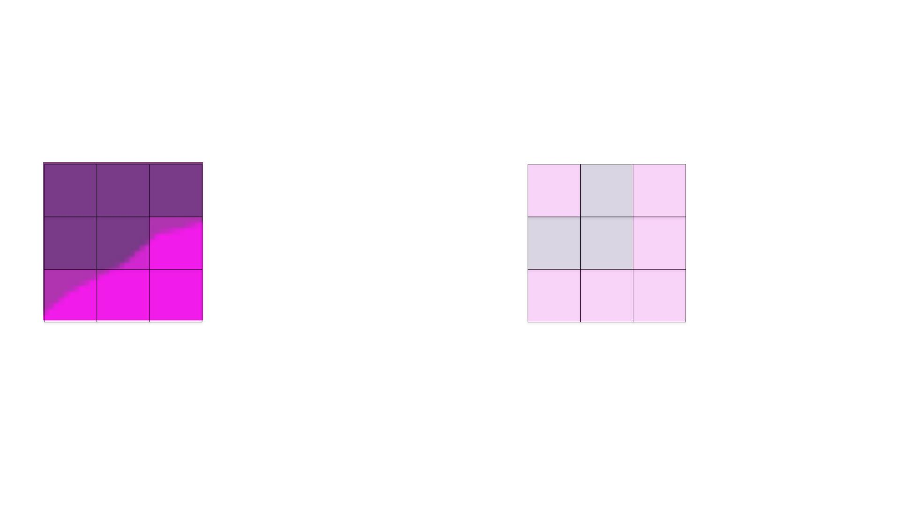
Evaluation Metrics
Ground Truth
Prediction
R R R
S R S
R R S
R R S
S
S
S
S
S
S

Slide 12
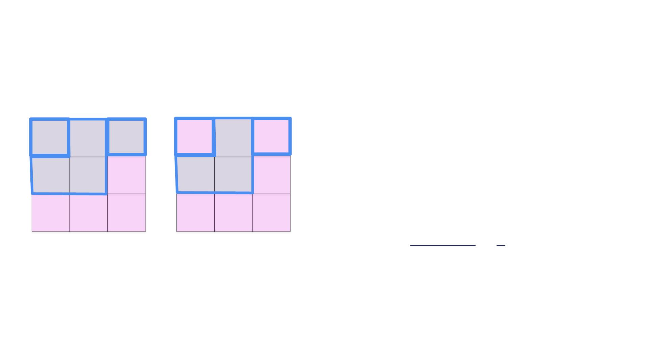
Evaluation Metrics
Ground Truth
R R R
R R S
Prediction
Class: Road
S R S
R R S
!" = $
%" = &
%' = (
S
S
S
S
S
S
3
3
)* +_{,-./}
=
=
3 + 0 + 2 5

Slide 13
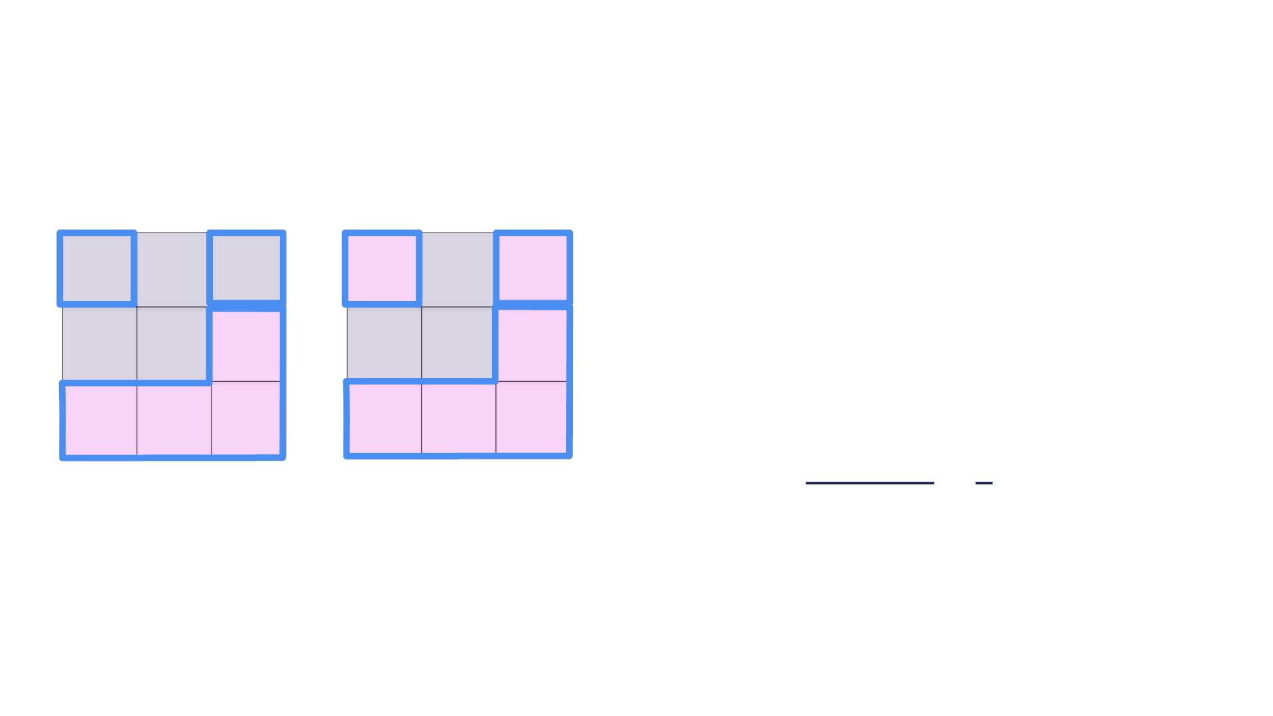
Evaluation Metrics
Ground Truth
R R R
R R S
Prediction
Class: Sidewalk
S R S
R R S
!" = $
%" = &
%' = (
TP+FNはいつもground truthの数だ
TP+FPはいつも予測結果の中の陽性の数だ
S
S
S
S
S
S
4
4
)* +_{,-./}
=
=
4 + 2 + 0 6

Slide 14
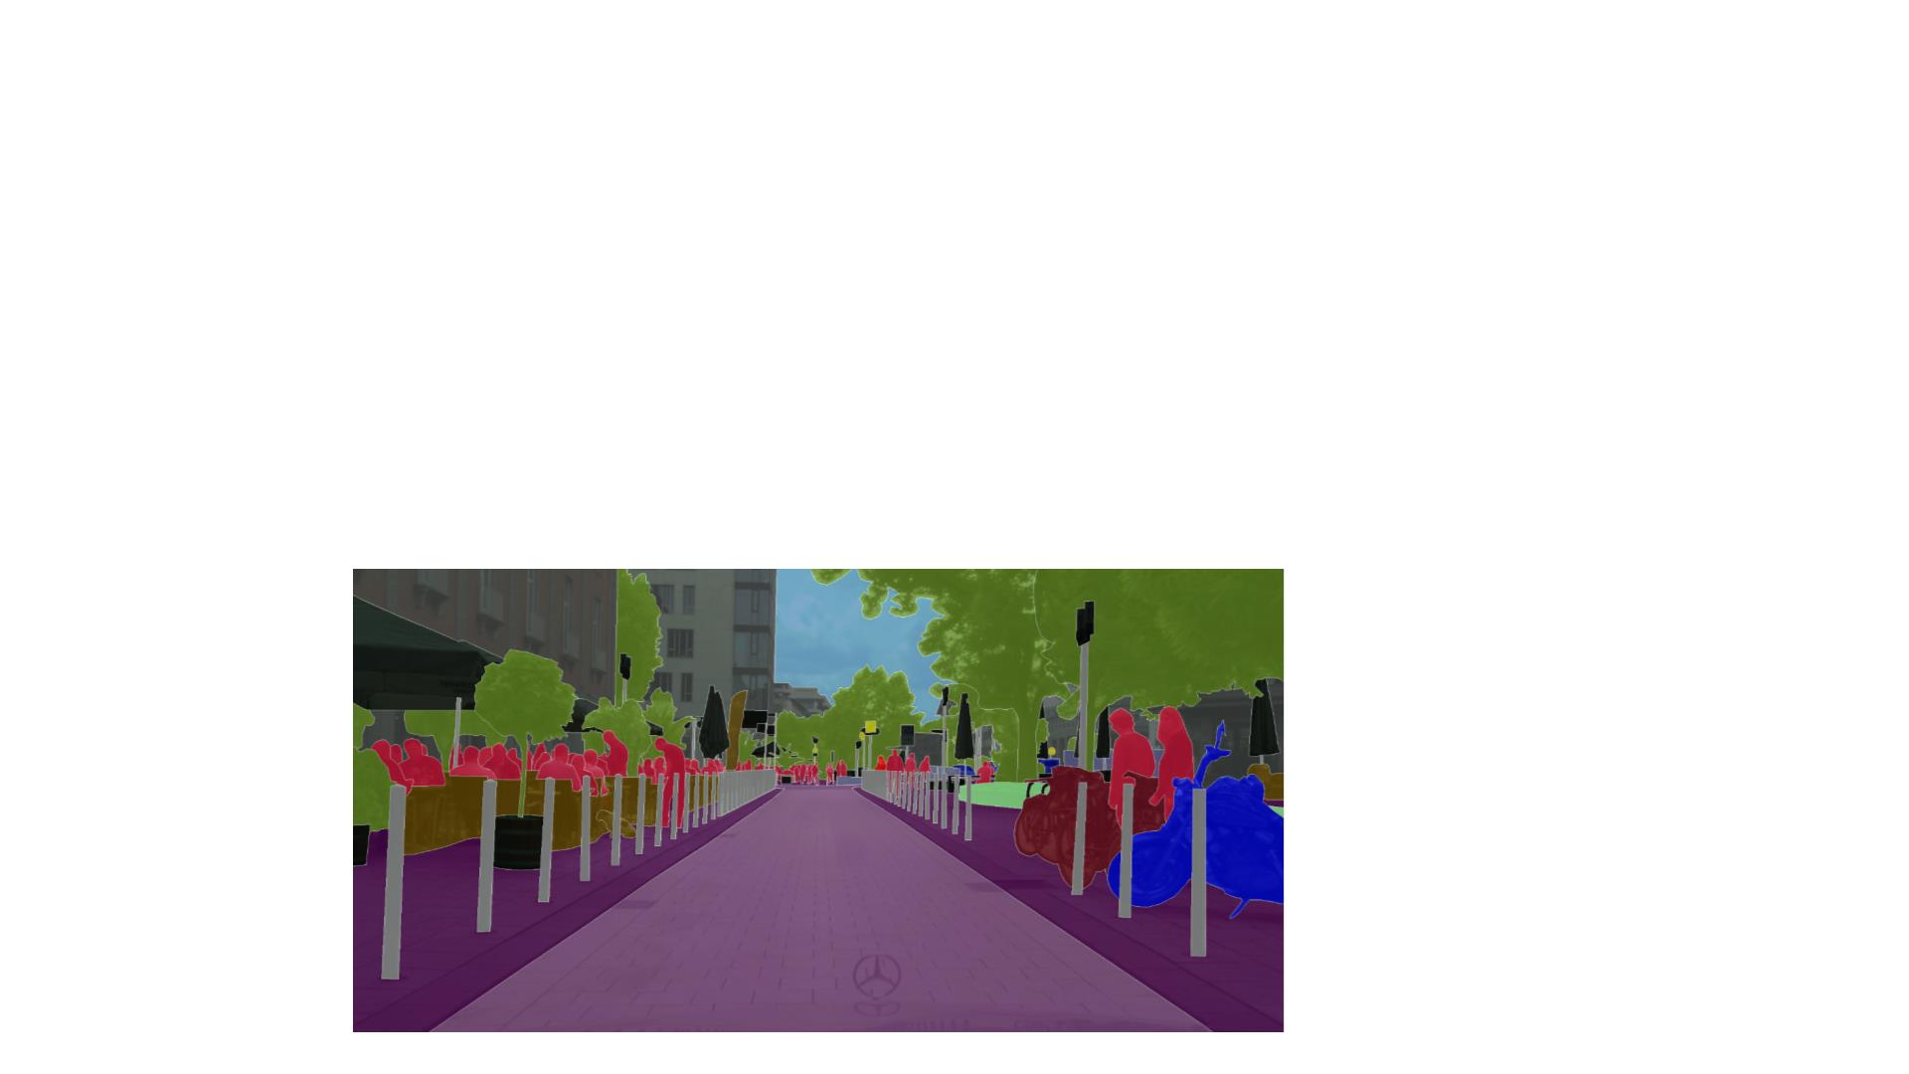
Evaluation Metrics
Computing the IOU per image and then averaging will actually give you an incorrect class IOU score.
• Class IOU over all the data is calculated by computing
the sum of TP, FP, FN for all images first
• Averaging the class IOU is usually not a very good idea!
• CityScapes Segmentation Dataset
つまりclass毎にIOUを計算するまで。
https://www.cityscapes-dataset.com/
The CitySpaces benchmark is one of the most used benchmarks for evaluating semantic segmentation algorithms.

Slide 15
Summary
• Semantic segmentation consists of providing a class
label for every pixel in a 2D image
• Semantic segmentation models can be evaluated
using class IOU
• Next: ConvNets for Semantic Segmentation

Slide 16
Convolutional Neural Networks For Semantic
Segmentation
Course 3, Module 5, Lesson 2

Slide 17
Learning Objectives
• Learn how to use convolutional neural networks to
perform the semantic segmentation task
• Learn the different layers required for the good
performance of semantic segmentation models
Using ConvNets for semantic segmentation is actually a little easier than using them for object detection.
Unlike ConvNets for object detection, the training and inference stages are practically the same for semantic segmentation.

Slide 18

ConvNets For Semantic Segmentation
! "; $
ConvNet

Slide 19
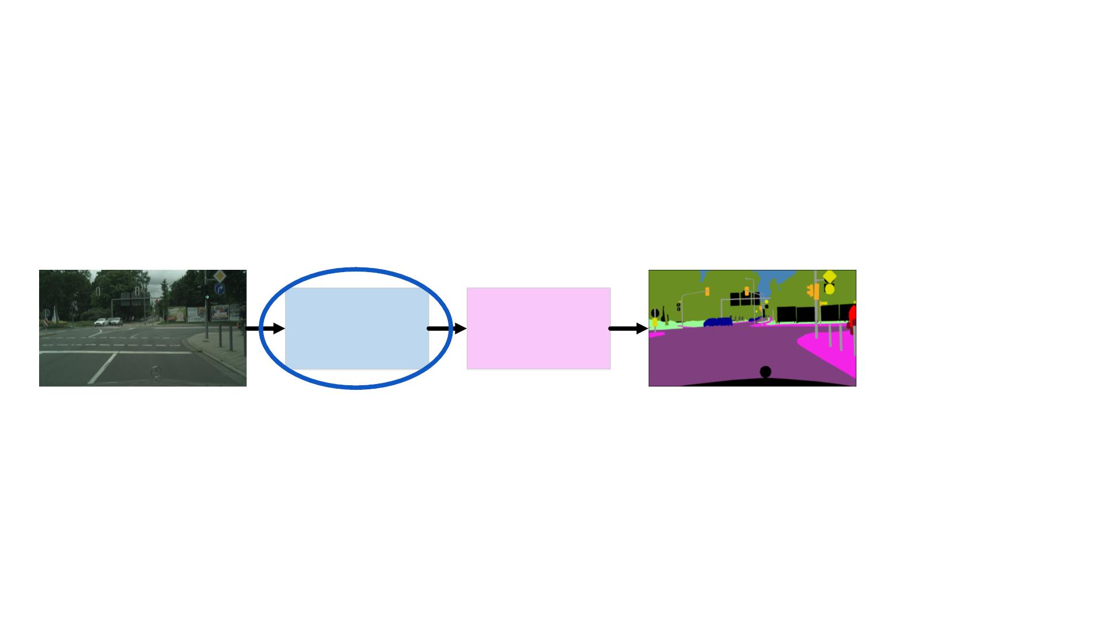
ConvNets For Semantic Segmentation
Feature
Extractor
Output
Layers

Slide 20
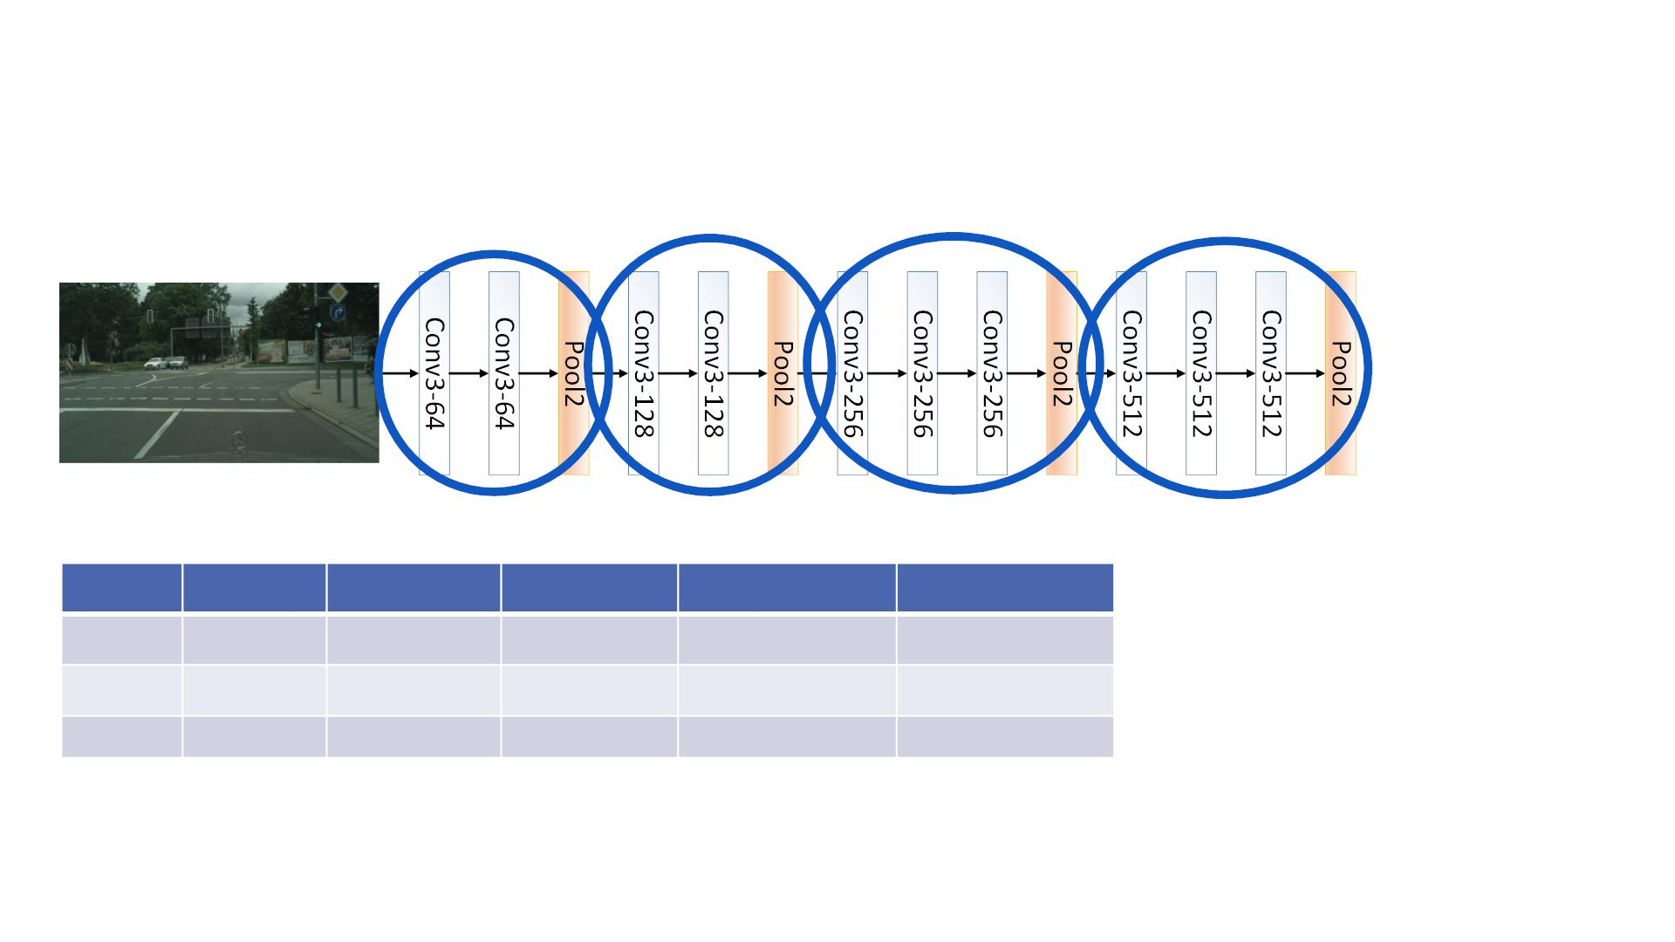
The Feature Extractor
Pooling Layerを使っちゃだめかも、pooling layerを使うと、feature mapのサイズが縮むので、 Semantic Segmentationのpixel毎のClassificationと⽭盾するでしょう。
Image
Conv1
M/2
N/2
Conv2
M/4
Conv3
M/8
Conv4
M/16
N/16
512
Width
Height
Depth
M
N
3
N/4
N/8
64
128
256

Slide 21
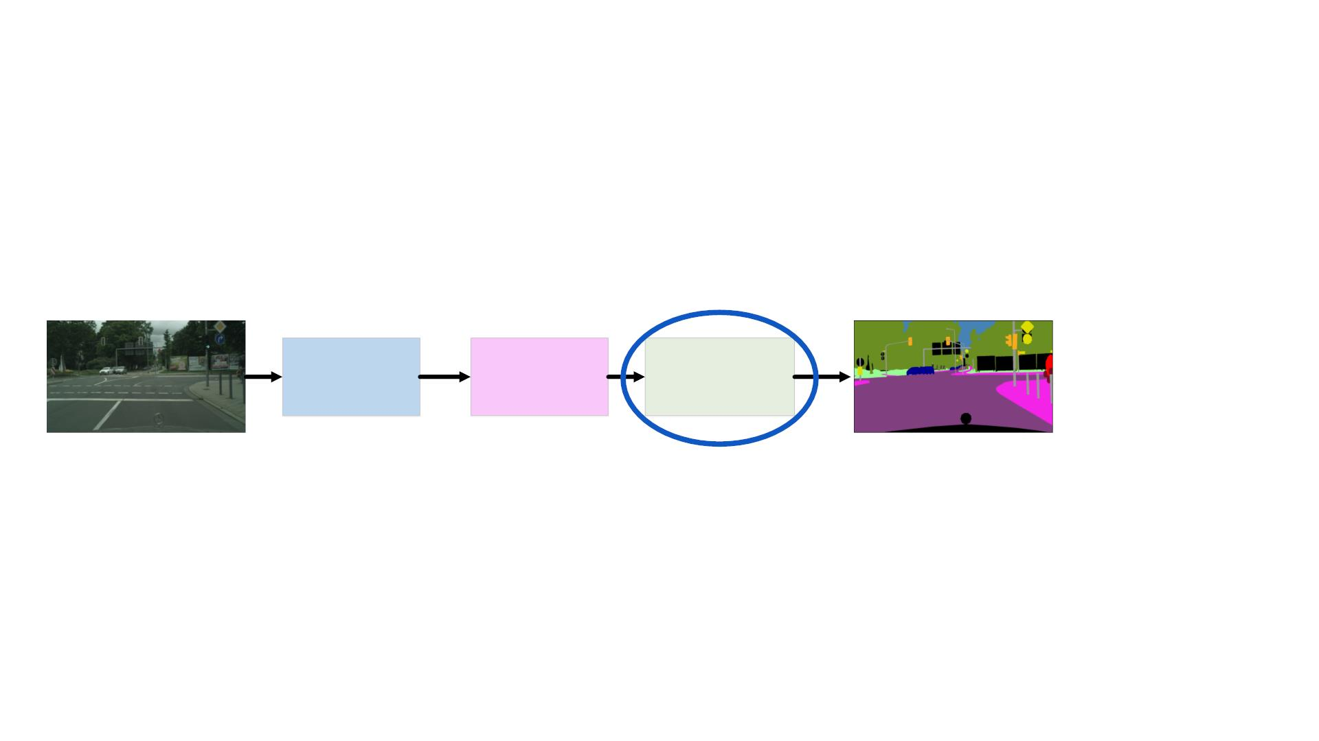
Upsampling the Output
Feature
Extractor
Output
Layers
Upsampling

Slide 22
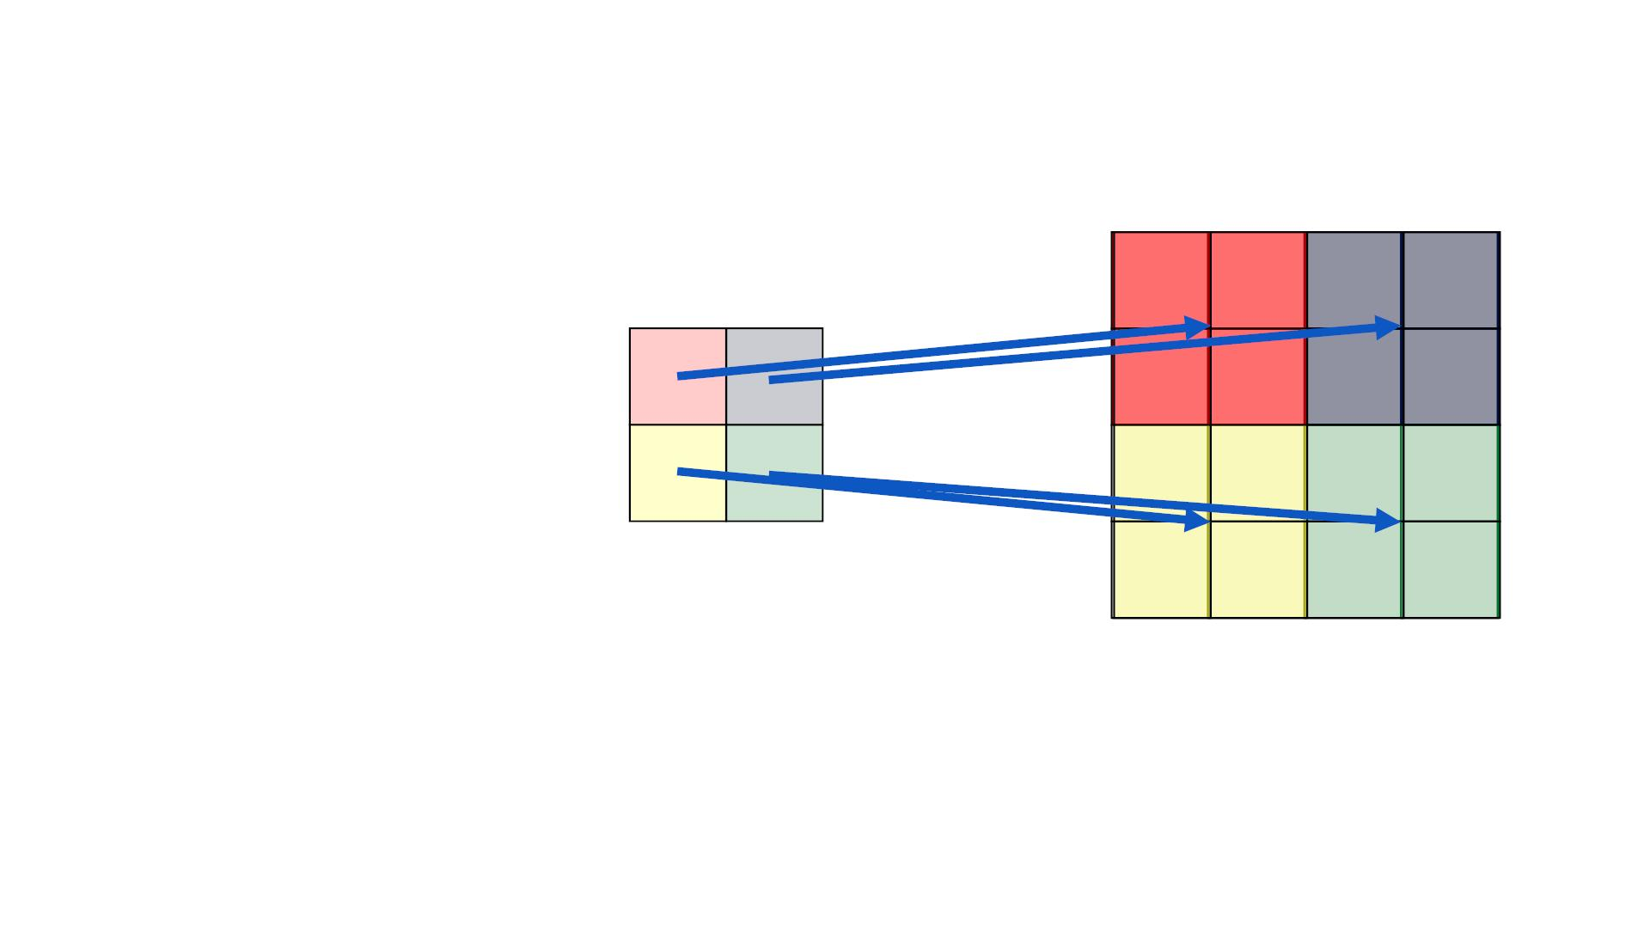
Upsampling Layer
• Upsampling Multiplier !
!!"# = #×!$%
%
&'(
%
#$
% = #×%
"#$
"&'(
!"#
& = &
$%
!"#
$%
なぜnaïve unsamplingじゃ足りない？Parameters足りないからでしょう！ほぼparametersなし（poolingと同じ）。Parametersの数は能力のcapacityだ！

Slide 23

Upsampling The Output
Naive Upsamplingをやっても変わらない。 Smooth boundariesを得るのは難しい。

Slide 24
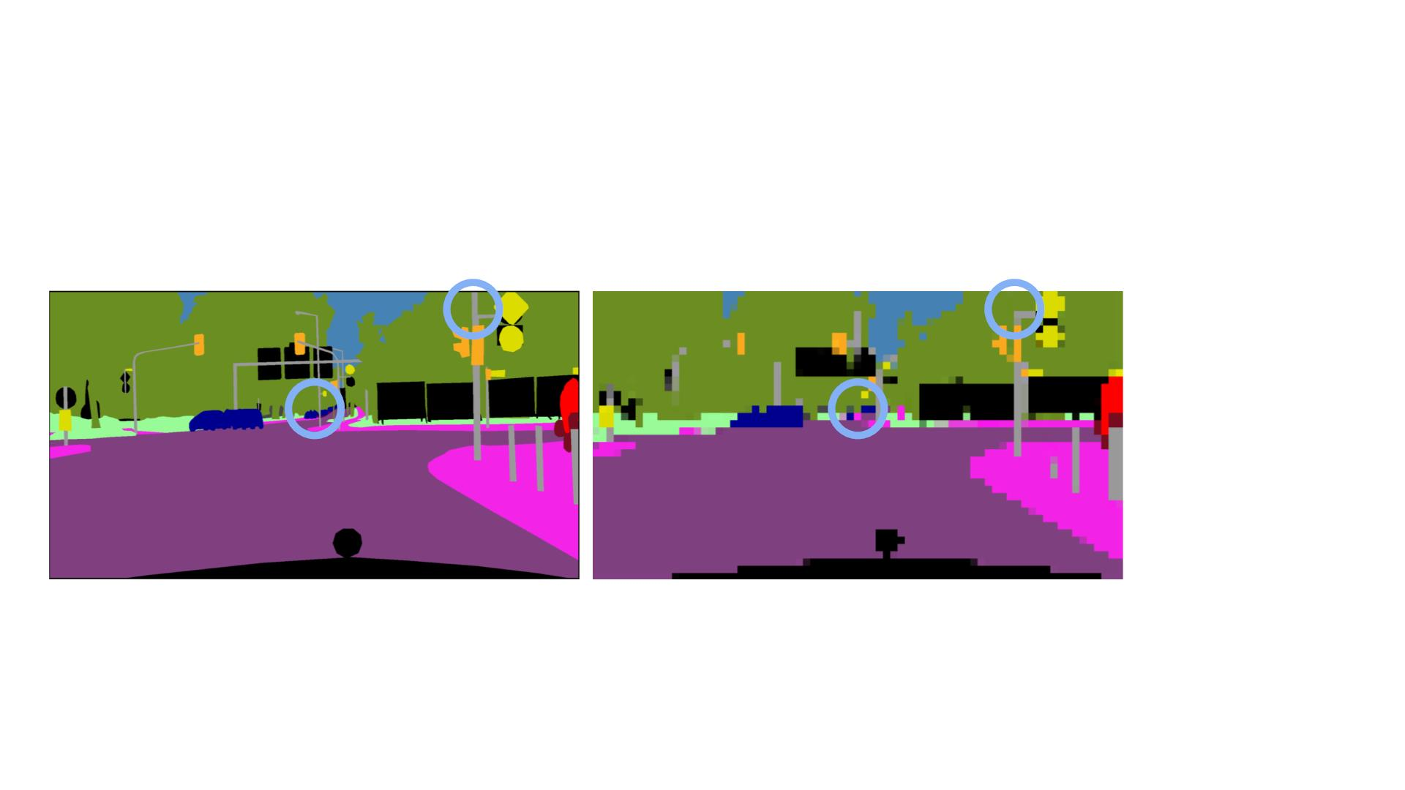
Upsampling The Output
Naïve unsamplingのもう１つ課題：any object less than 16 pixels in width or height usually fully disappears in their unsampled image.
解決策：Naive Upsamplingじゃなく、Feature Decoder ！

Slide 25
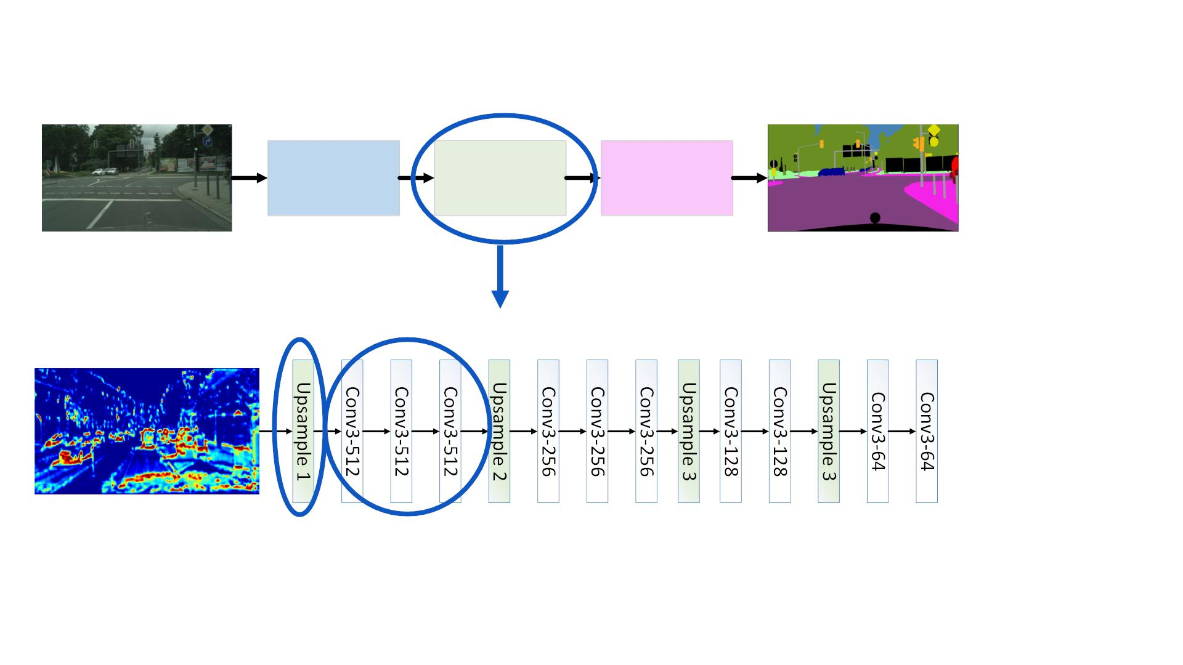
Learning Same Resolution Feature Maps
Feature
Extractor
Feature
Decoder
Output
Layers

Slide 26
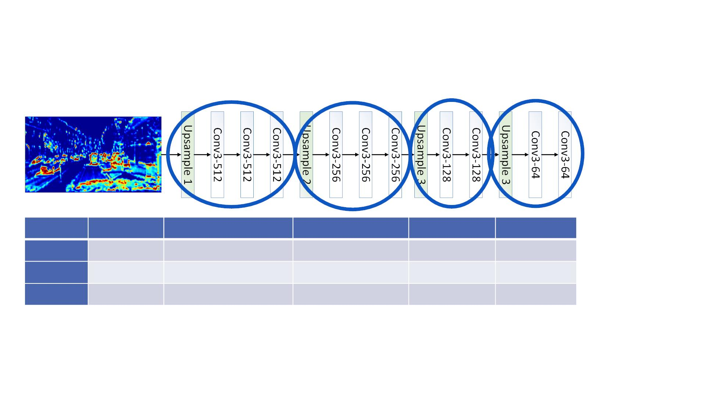
The feature decoder can be thought of as a mirror image of the feature extractor.
The Feature Decoder
Feature Map
M/16
Deconv1
M/8
Deconv2
M/4
Deconv3
M/2
Deconv4
Width
Height
Depth
M
N
N/16
N/8
N/4
N/2
512
512
256
128
64
The Upsampling usually using nearest neighbor methods achieves the opposite effect to pooling, but results in an inaccurate feature map.
The following convolutional layers are then used to correct the features in the upsampled feature map with learnable filter banks.
This correction usually provides the required smooth boundaries as we go forward through the feature decoder.

Slide 27
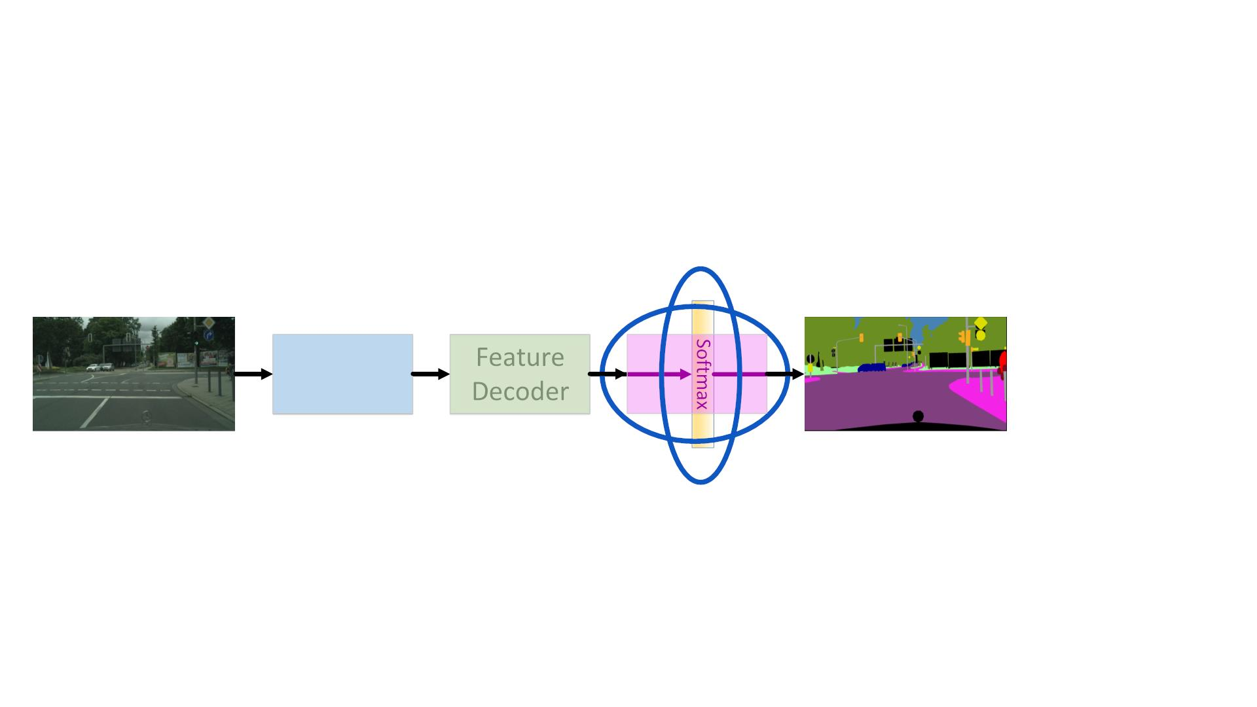
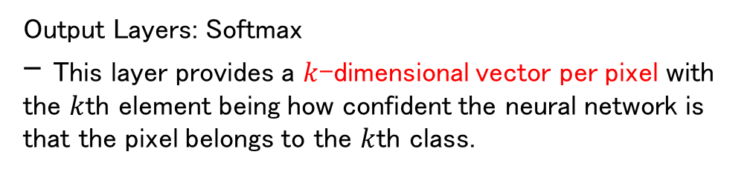
Learning Same Resolution Feature Maps
Feature
Extractor
Feature
Decoder
Output
Layers
Output Layers: Softmax
- This layer provides a $k$-dimensional vector per pixel with the $k$th element being how confident the neural network is that the pixel belongs to the $k$th class.

Slide 28
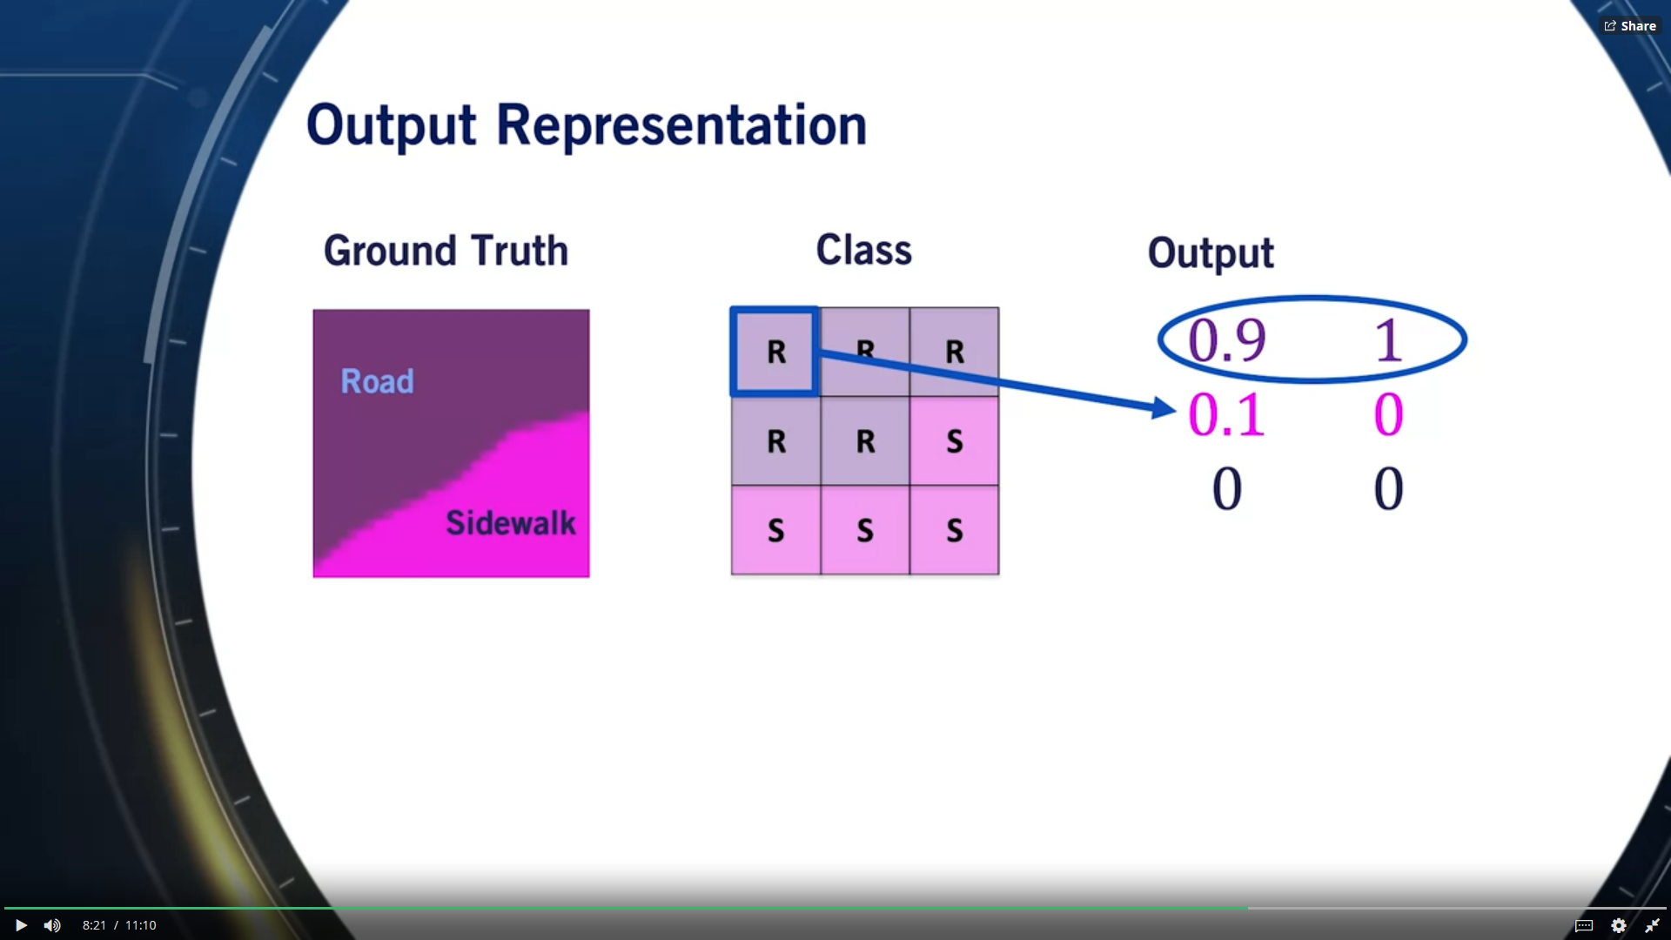

Slide 29

Classification Loss
1
! =
∗
% &'())*+,'(-.() , ) )
!"#
$$%$&"
' '
'
• ! is the number of pixels in all images of our
23245
minibatch
• " is the output of the neural network
6
∗
• " is the ground truth classification
6

Slide 30
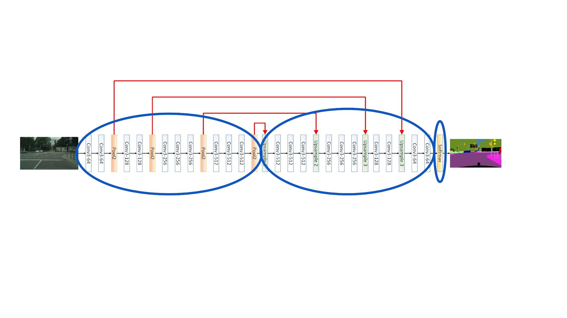
ConvNets For Semantic Segmentation

Slide 31
Summary
• Convolutional Neural Networks can be used to solve
the semantic segmentation problem
• In a feature extractor and a feature decoder are
required to provide the final output of semantic
segmentation models
• Next: Semantic Segmentation For Autonomous Driving
[2017] Pyramid Scene Parsing Network:
https://arxiv.org/abs/1612.01105
またSenseTimeの論 ⽂！
[2016] SegNet: A Deep Convolutional Encoder-Decoder Architecture for Image Segmentation: https://arxiv.org/abs/1511.00561

Slide 32
Semantic Segmentation For Road Scene
Understanding
Course 3, Module 5, Lesson 3

Slide 33
In the context of semantic segmentation, the drivable surface includes all pixels from the road, crosswalks, lane markings, parking spots, and even sometimes rail tracks（線路）.
Estimating a drivable surface is very important as it is one of the main steps for constructing occupancy grids from 3D depth sensors.
Learning Objectives
• Learn how to use the output of semantic
segmentation models to perform drivable space
estimation
• Learn how to use the output of semantic
segmentation models to perform semantic lane
estimation
1.路面や2.レーンの予測。

Slide 34
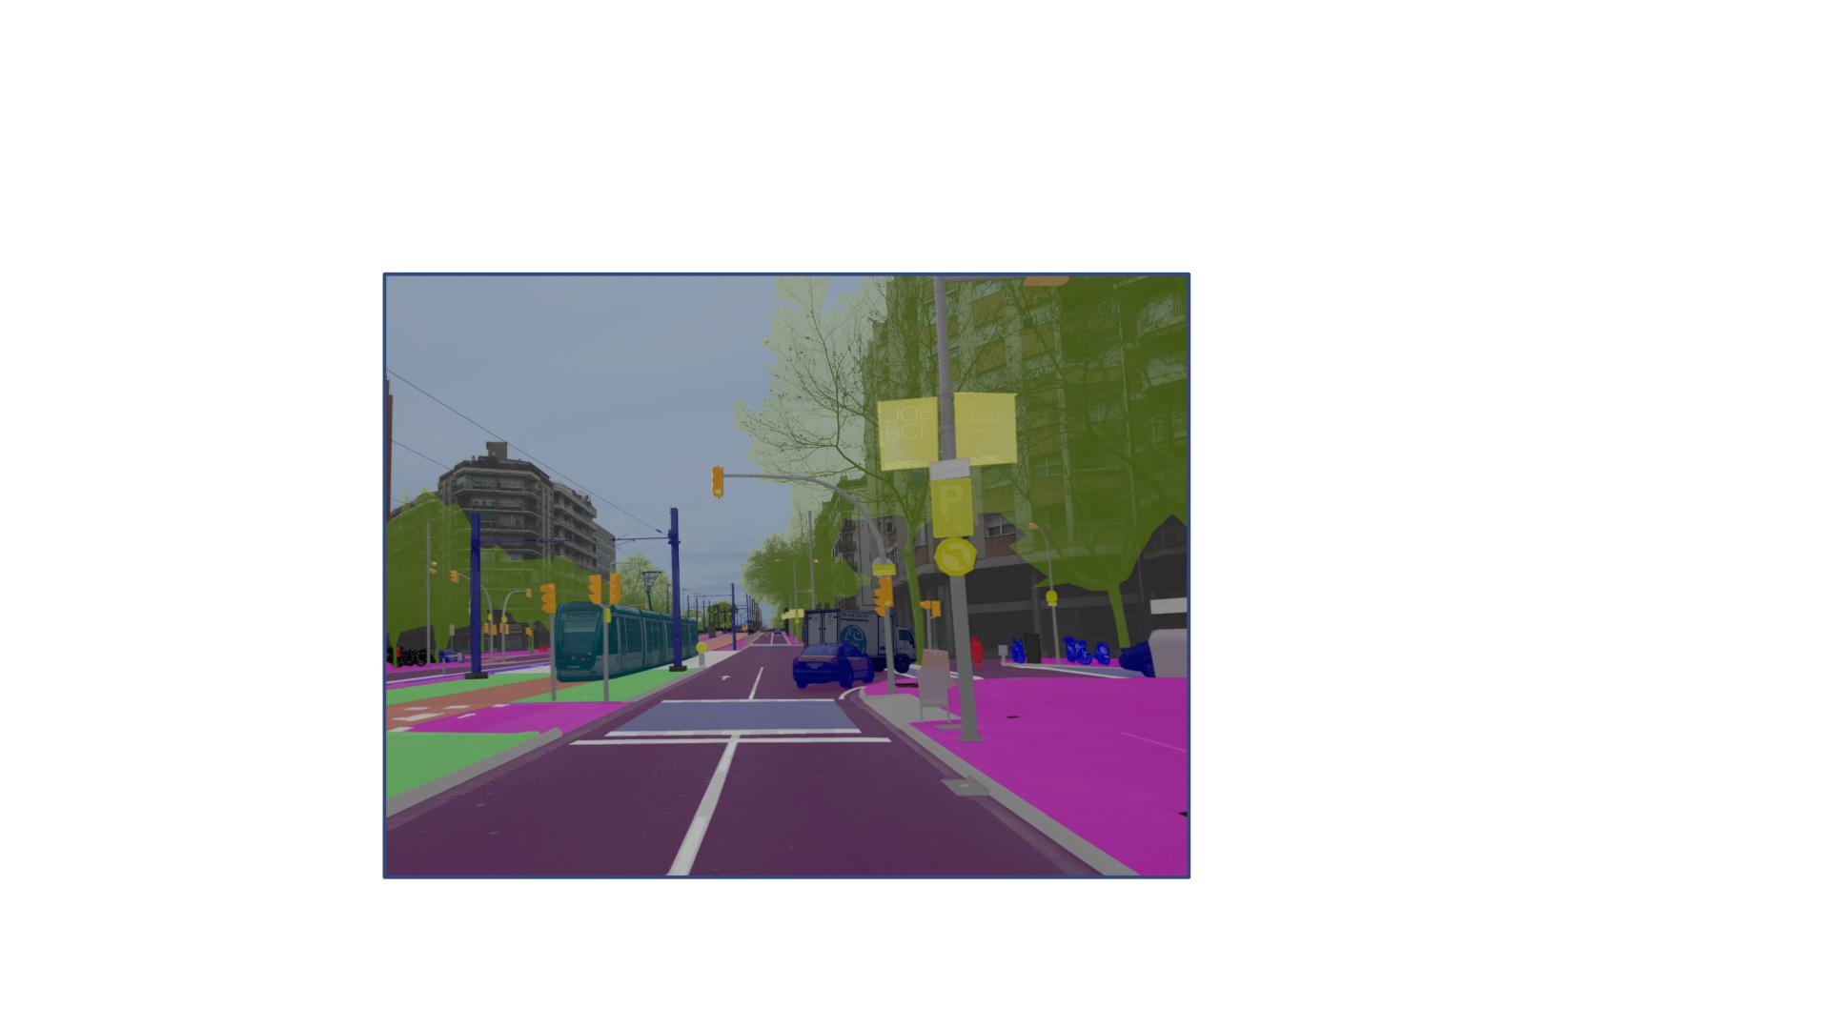
Semantic Segmentation Results
Data From:
https://www.mapillary.com/dataset/vistas?pKey=rwbBtYKofke2NeLIvj8j-A

Slide 35
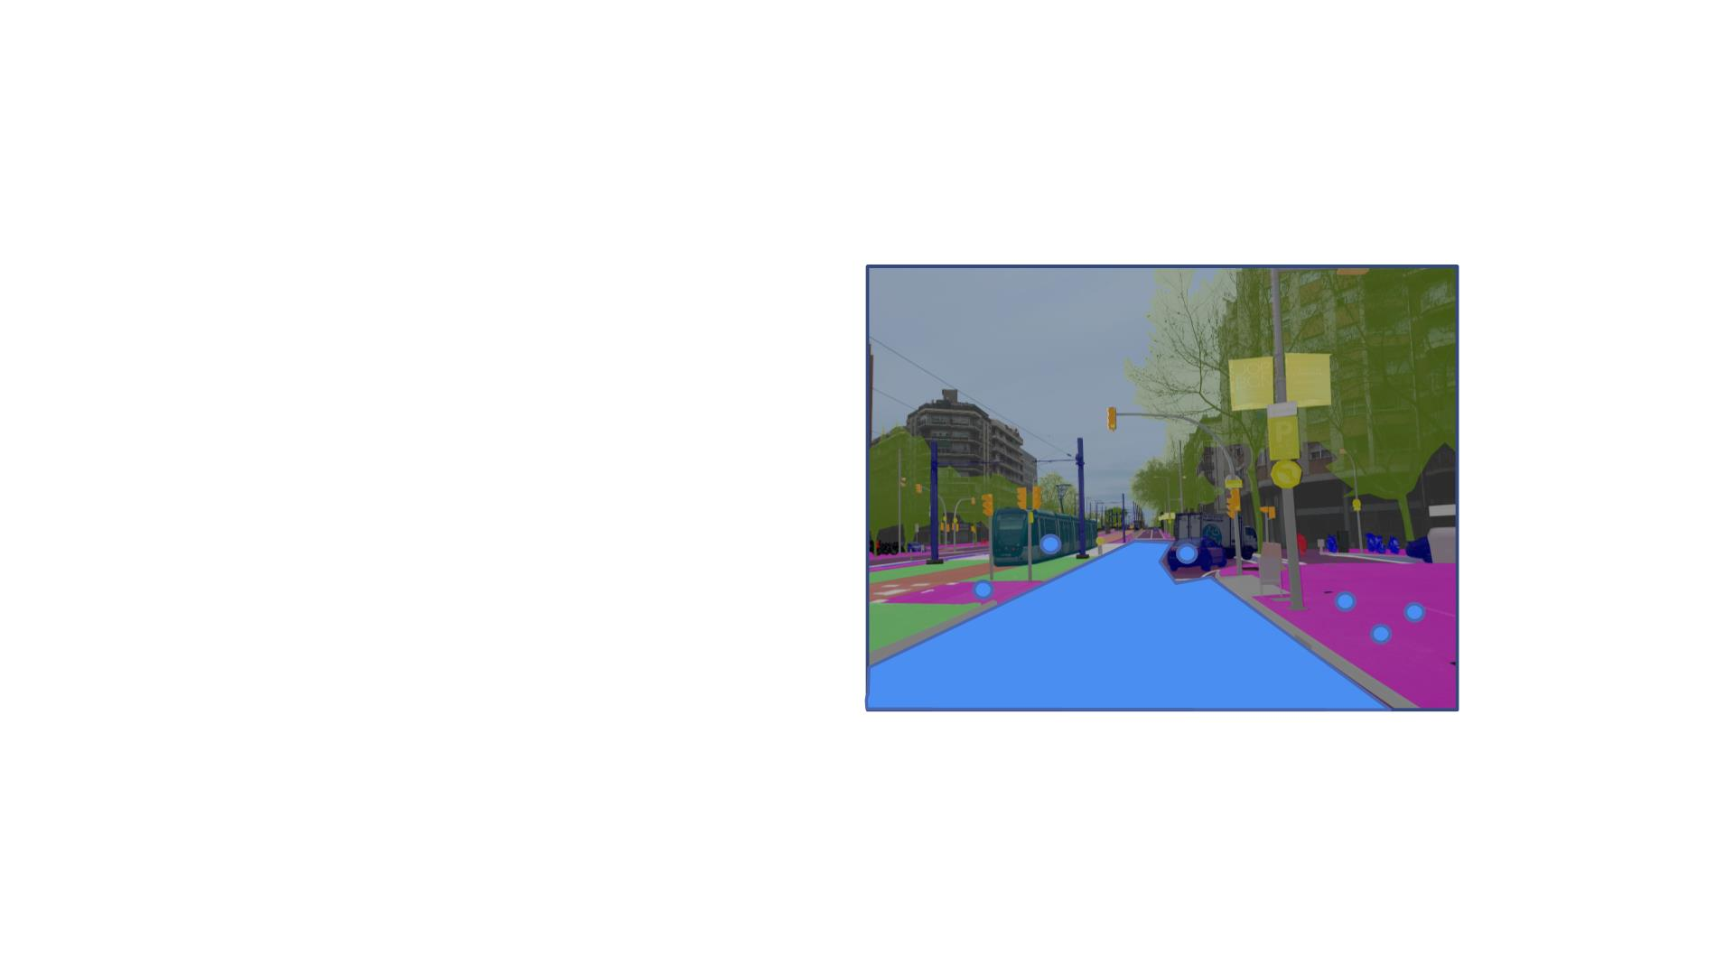
3D Drivable Surface Estimation
1. Generate semantic
segmentation output
2. Associate 3D point
coordinates with 2D image
pixels
3. Choose 3D points
belonging to the Drivable
Surface category
either from stereo data or by projecting a LiDAR point cloud to the image plane.
4. Estimate 3D drivable
surface model
The complexity of this model can range from a simple plane to more complex spline（スプライン） surface models.
splineという⾔葉はMatLabのDrivingScenario toolboxにも⾒たことがある。点列から道路 を作る時！

Slide 36

3D Drivable Surface Estimation
• Plane Model:
!" + $% + & = (
• Least squares formulation:
! = #, %, & , argmin .! − 0
-
1 3 −1
−8₂
−8
2
2
1 3 −1
5
. =
5
5
, 0 =
⋮ ⋮ ⋮
⋮
1 3 −1
−8₇
7
7
• Solution:
! "# !
) = * * * +

Slide 37
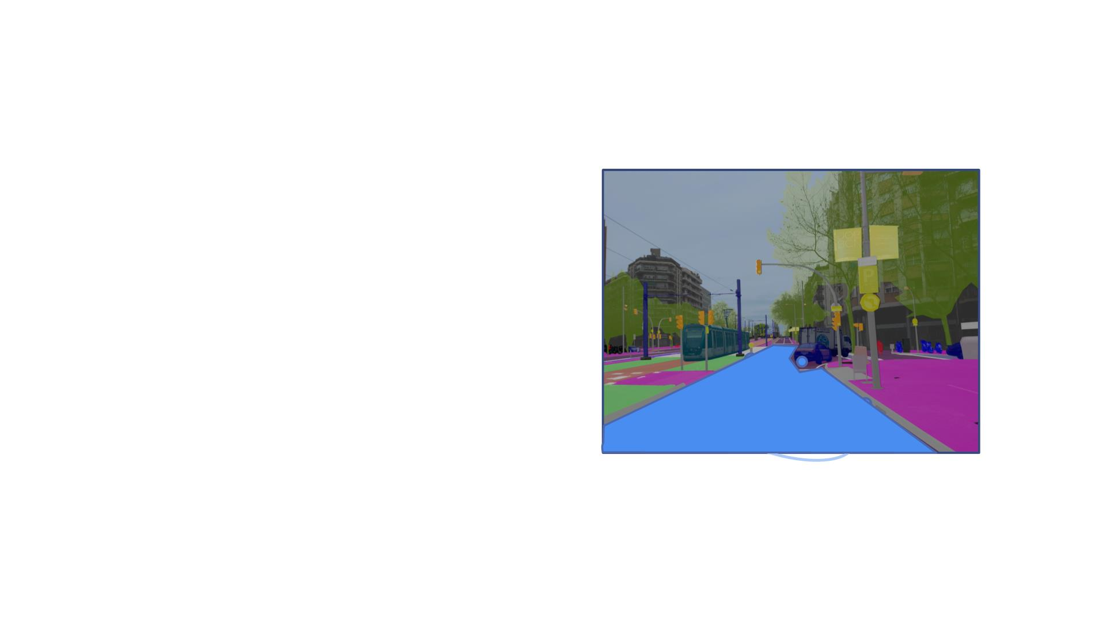
3D Drivable Surface Estimation
Outliers対応（Batch Least Squares簡単ですが、OutliersのせいでPlaneの品質が悪くなったりする）
• Minimum number of points to estimate
model: 3 non-collinear（非共線）points
• RANSAC Algorithm:
1. From your data, randomly select 3 points.
2. Compute model parameters !, ", and #
using least squares estimation.
3. Compute number of inliers, N.
4. If N > threshold, terminate and return the
computed plane parameters. Else, go back
to step 1.
5. Recompute the model parameter using all
the inliers in the inlier set.

Slide 38
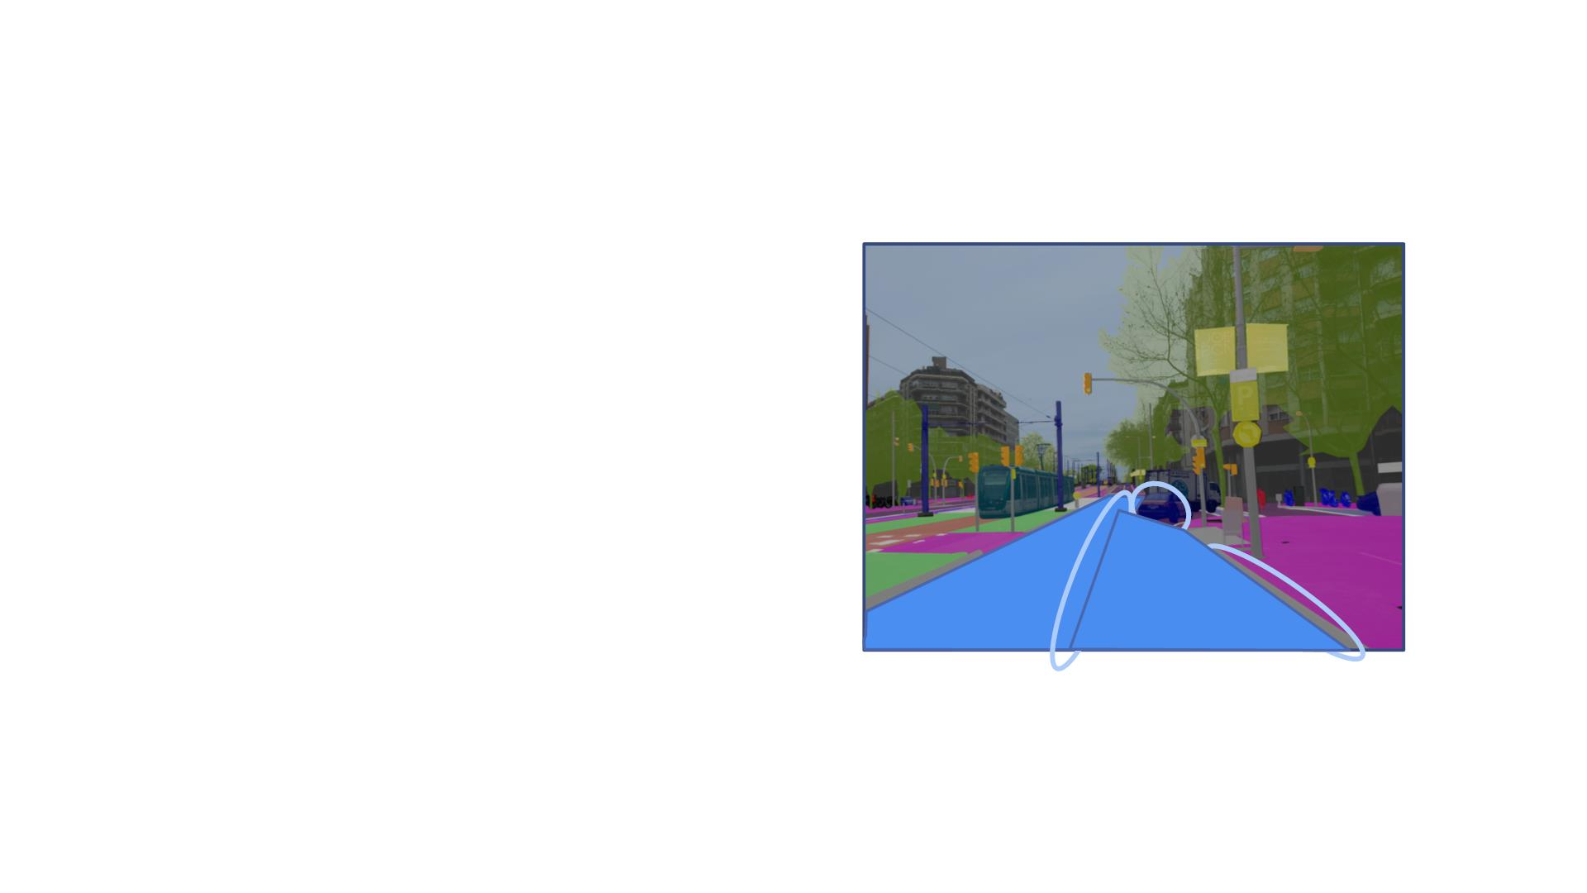
Semantic Lane Estimation
• Estimate the lane, the area where
the car can drive on the drivable
surface
• Estimate what is at the boundaries
of the lane:
o Curb
o Road
o Car
The self-driving car has to base its maneuvers on what objects occur at the boundary of the lane, especially during emergency pull overs.
Semantic lane estimationのタスクはestimating the lane and what occurs at its boundaries.

Slide 39
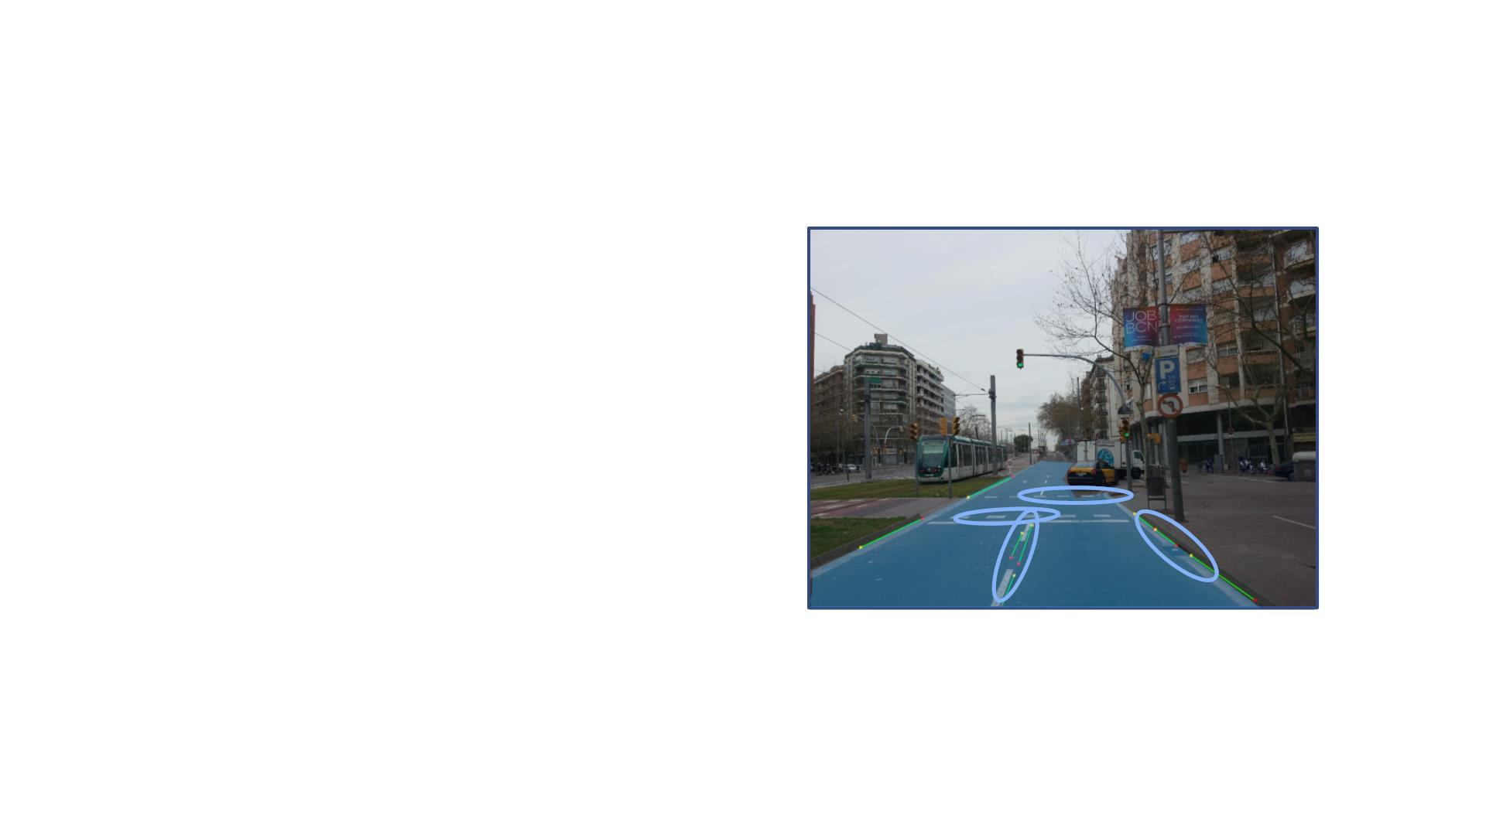
Semantic Lane Estimation
Here, use canny edge detector.
The output are pixels classified as edges that will be used to estimate the lane boundaries.
1. Extract segmentation mask from pixels
belonging to lane separators such as lane
markings or curbs.
2. Extract edges from this segmentation mask
using an edge detector.
3. Linear Lane Model: Use the Hough transform
to detect lines in the output edge map.
4. Filter lines based on slope to remove
horizontal lines.
5. Remove any line that does not belong to the
drivable space.
6. Determine which classes occur at the
boundary of the lane.
Given an edge map, the Hough transform(ハフ変換) can generate a set of lines that link pixels belonging to edges in the edge map.
The minimum length of the required lines can be set as a hyperparameter to force the algorithm to only detect lines that are long enough to be part of lane markings.
例えば⾞のedgeがboundaryに出たら。

Slide 40
Auxiliary Material
• Hough Transform Line Detection:
https://docs.opencv.org/3.4.3/d9/db0/tutorial_hough_lines.html
• Canny Edge Detection:
https://docs.opencv.org/3.4.3/da/d22/tutorial_py_canny.html

Slide 41
Semantic lane detection and drivable surface estimation are the most prominent uses for semantic segmentation models in the context of self-driving cars.
Summary
• Semantic Segmentation Results can be used to
estimate drivable space, and what classes occurs at
its boundaries
• Semantic Segmentation Results can be used to
estimate lanes
• Semantic Segmentation Results can be used to aid
in 2D object detection
Semantic segmentation is a powerful tool for self-driving cars and a core component of the high level perception stack.
• Next: Course Project

